Slide 1
Final Presentation
Seoyoon Choi
Division of Software, Data Science

Slide 2
Introduction
RotoNet: Rotoscoping-Based Artistic Style Transfer Networks

Slide 3
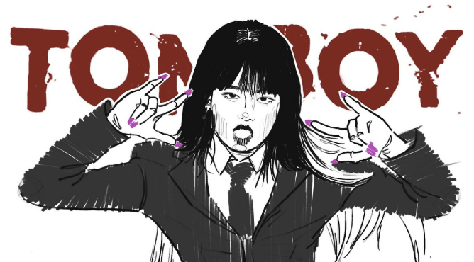
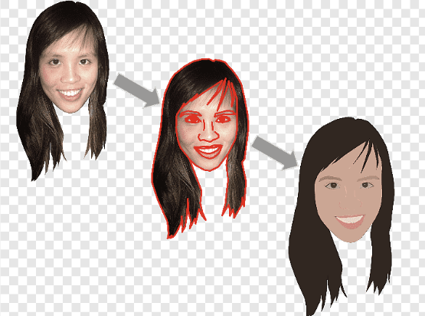
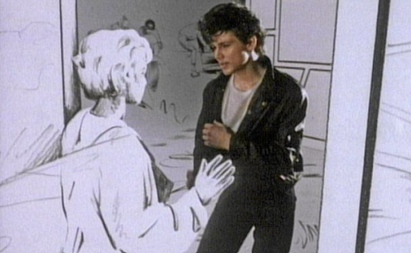
Introduction
Rotoscoping?

Slide 4
Introduction
RotoNet: Rotoscoping-Based Artistic Style Transfer Networks

Slide 5
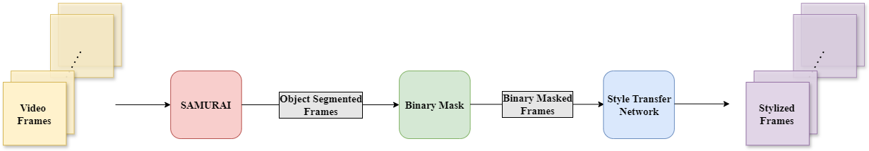
Methods

Slide 6
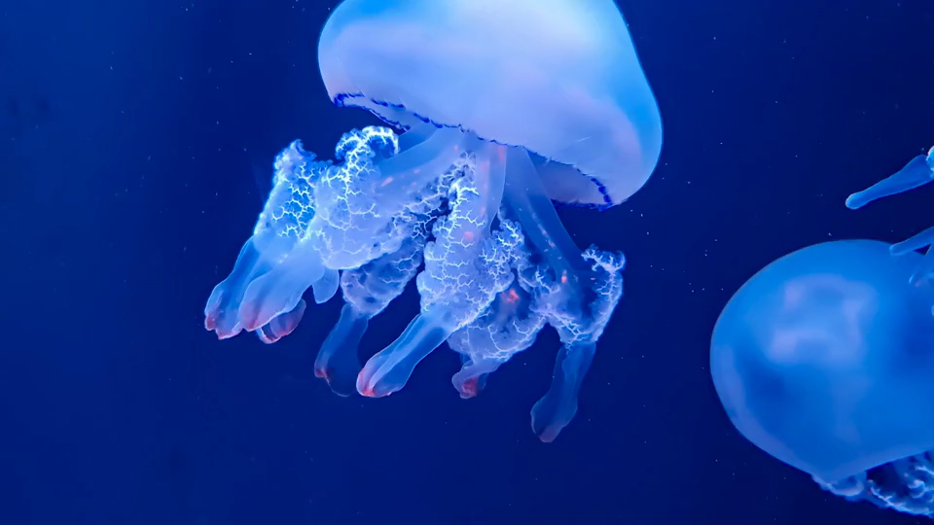
Methods

Slide 7
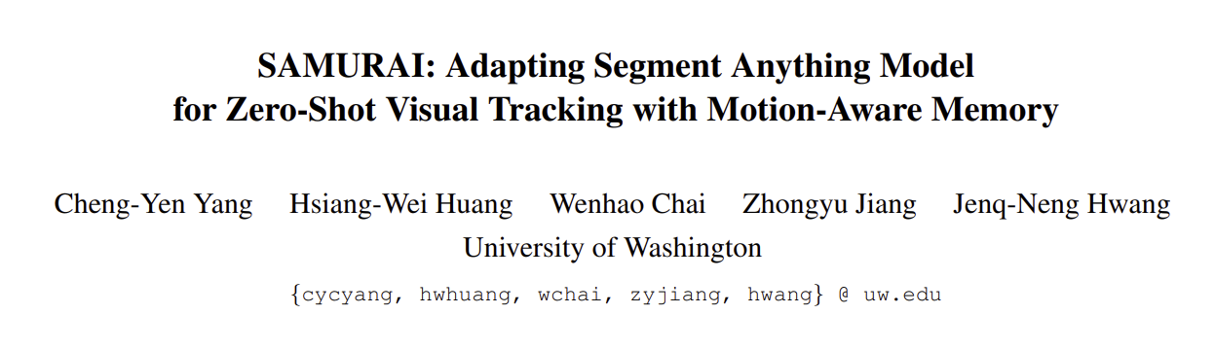
Methods

Slide 8
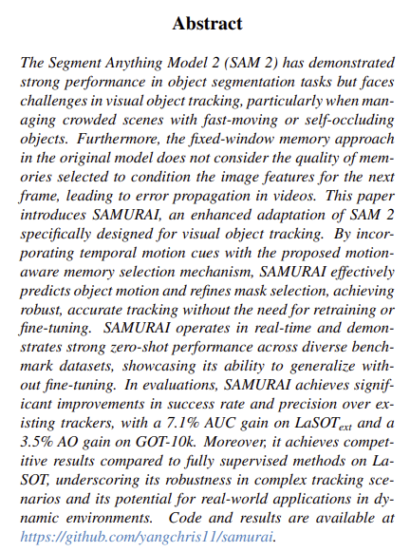


Methods

Slide 9
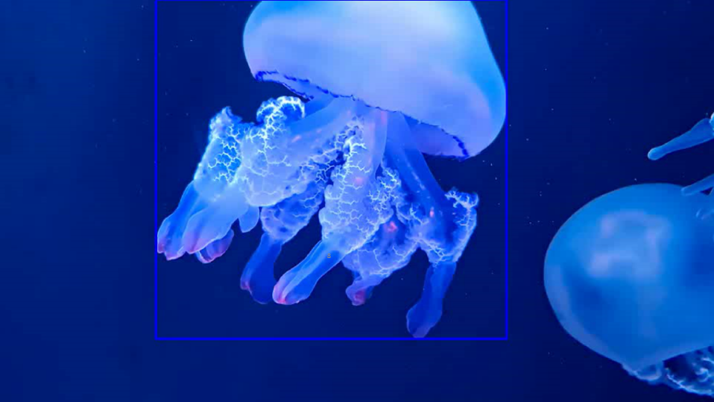
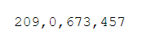
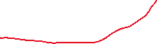



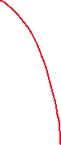

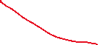

Methods
#1
(x, y, w, h)

Slide 10
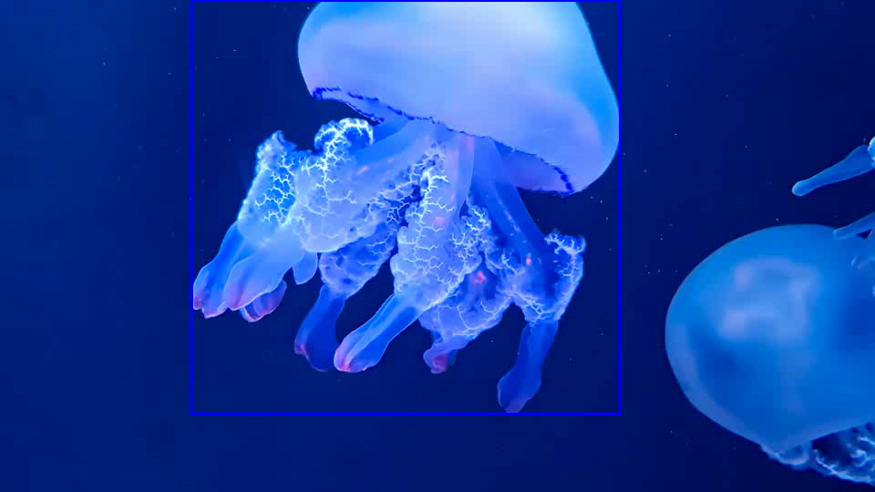
Methods

Slide 11
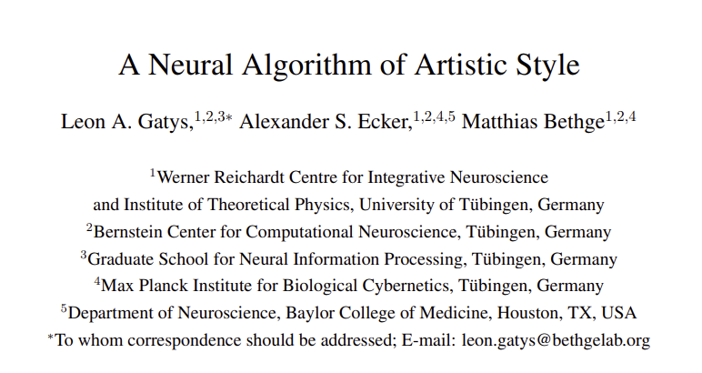
Methods

Slide 12
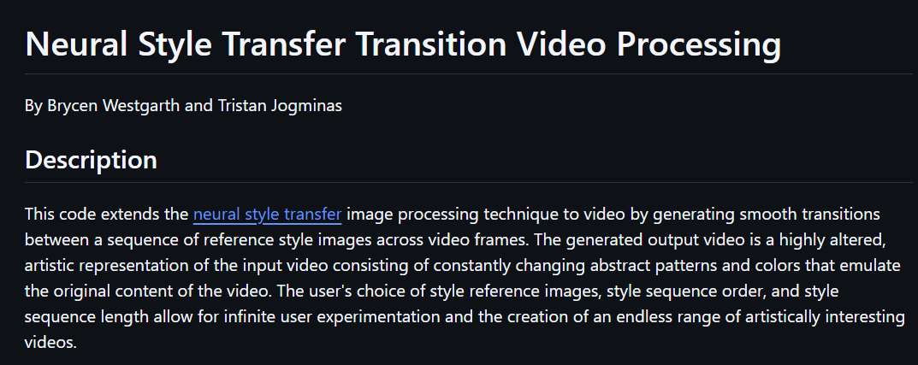
Methods

Slide 13
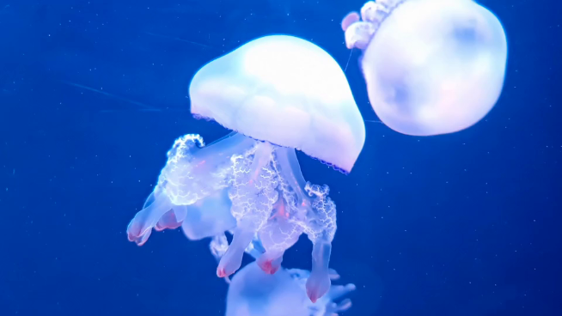
Experiments
#273
Original

Slide 14
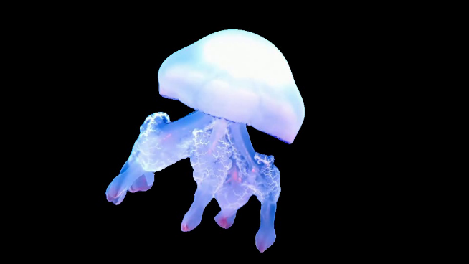
Experiments
#273
Object Segmentation & Tracking

Slide 15

Experiments
#273
Binary Mask

Slide 16
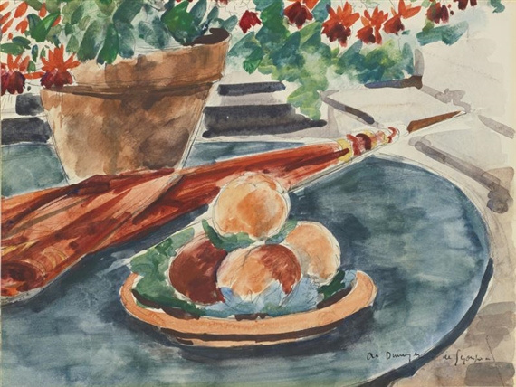
Experiments
Stylization

Slide 17
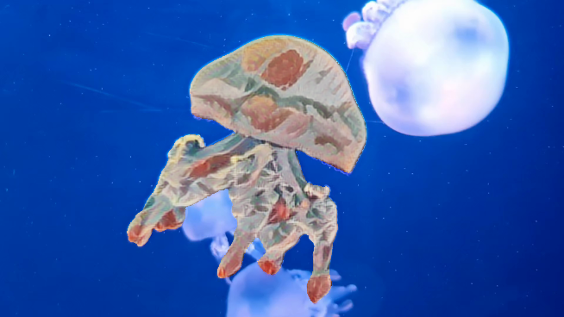
Experiments
#273
Stylization

Slide 18
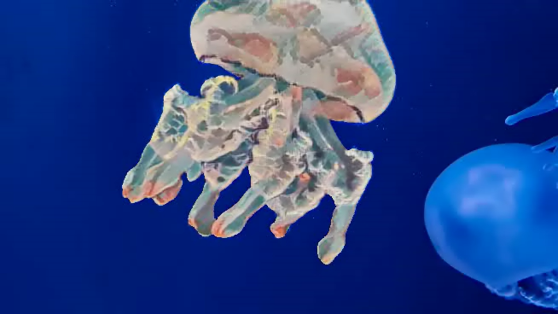
Result

Slide 19
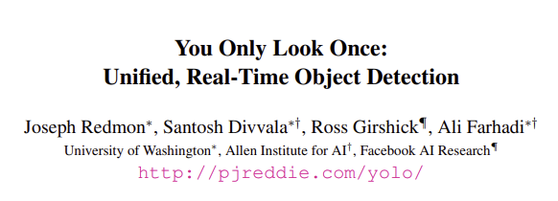
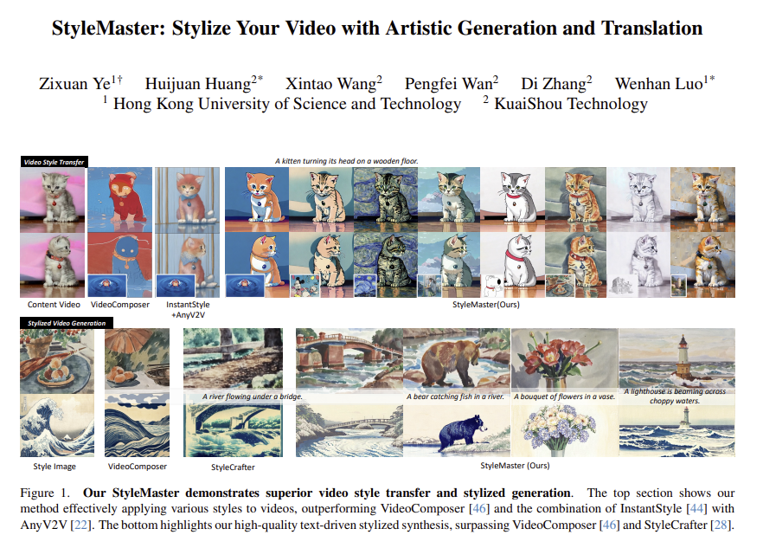
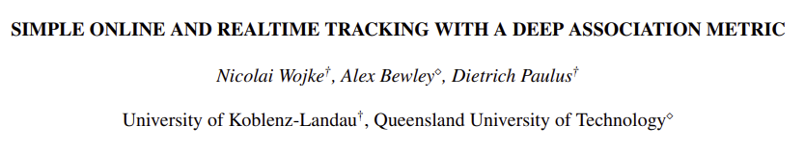
Conclusion
Comparison with YOLO+DeepSORT
2. Using Video Style Transfer Model

Slide 20
Thank You!

